Slide 1
CANDIDATE PROJECT
Ecommerce Analytics – Data Scientist
Rafael Ferreira Rodrigues

Slide 2
Task: Inventory Management
Business Problem
Inventory management is an important task at Best Buy: we need to order enough stock to satisfy customer demand while minimizing wasted warehouse space. With thousands of products available to buy at any given time, it can be difficult to create an accurate forecast for every product.
As our new Data Scientist, the Vice President of Inventory asks you to help:
“We need to understand how much inventory we need to buy for each of these key products. Can you build a model that provides guidance to our inventory analysts? Once you are done please build a presentation that explains your proof of concept to other executives in the company”

Slide 3
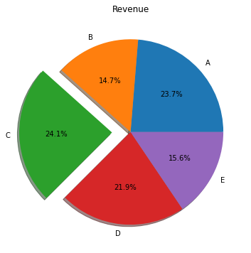
Products A, B, C, D, E

Slide 4
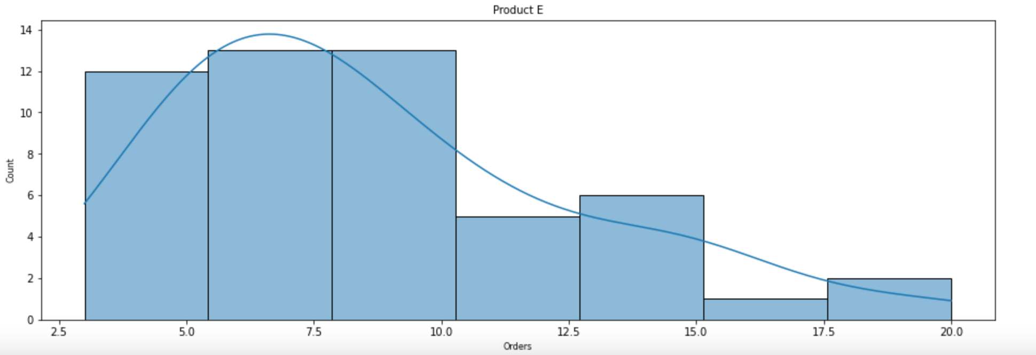
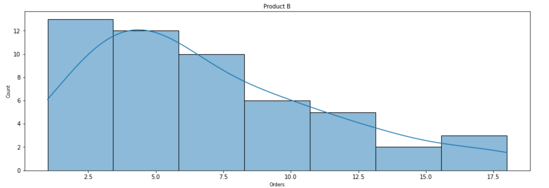

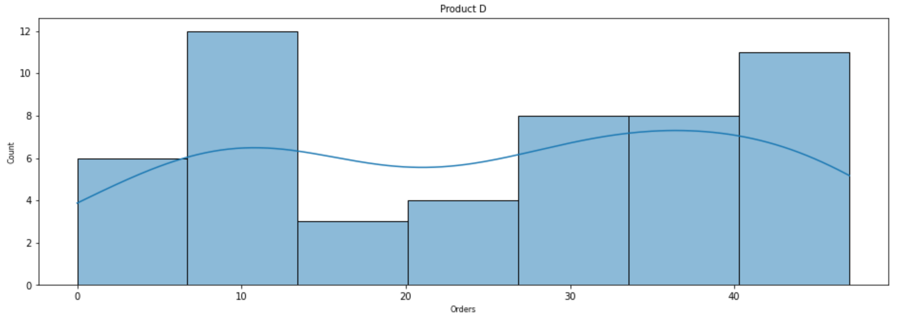

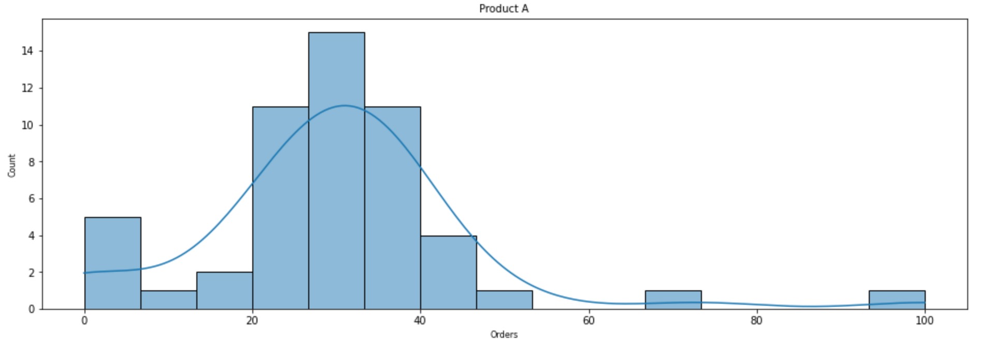

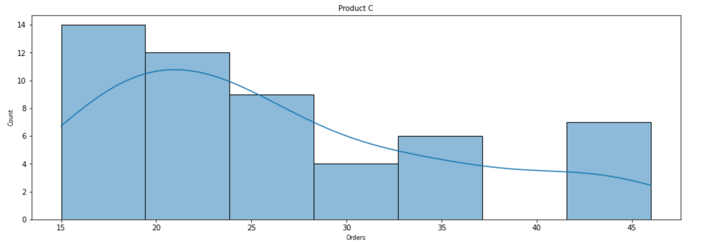
ORDERS

Slide 5
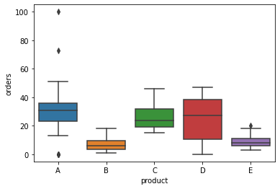
OUTLIERS & VARIANCE

Slide 6
MODELING GUIDANCE
Predict next week product orders:
Regression model (2 models tested);
Neural network model (one model tested);
Weekly replenish level orders

Slide 7
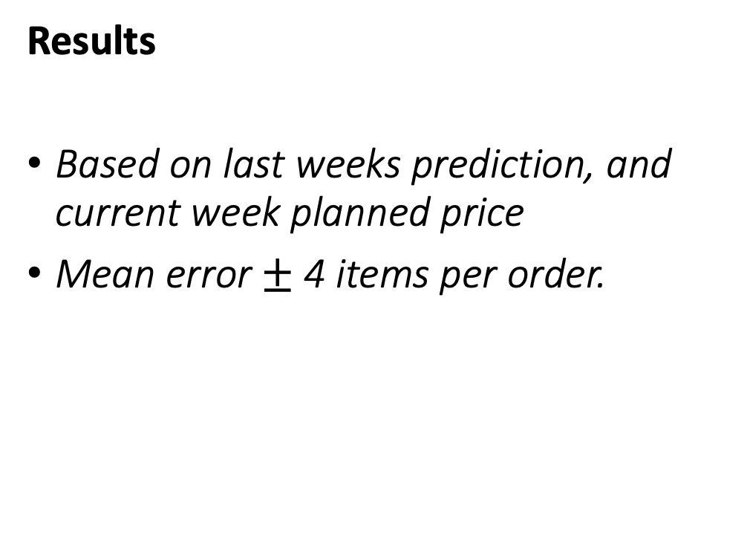
ORDERS PREDICTION
Results
Based on last weeks prediction, and current week planned price
Mean error $±$ 4 items per order.

Slide 8
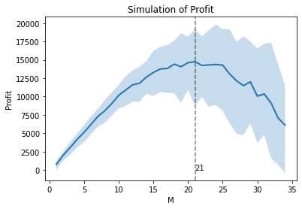
WEELKY REPLENISH

Slide 9
CONCLUSION
Orders prediction
Pros:
More predictable for the product supplier
Cons:
May not detect seasonal increases;
Won’t deal with outliers
Weekly Replenish
Pros:
May detect seasonal increases
Cons:
Vendor may not meet demand
Won’t deal with outliers

Slide 10
REFERENCE
GitHub: https://github.com/rfrod/bbuy_assignment/blob/main/BestBuy.ipynb

